Slide 1
Sentiment Analyzer
A GUI based Sentiment Analyzing tool that captures the sentence or a paragraph and displays the intents with the percentage.

Slide 2
Introduction
The year of 2010 which is considered to be the IT boom where a lot of companies began to market their products through E-commerce and also social media sites like Twitter , Instagram and Facebook is crucial. The data generated was huge and there were a lot of insights that companies got through the comments on the products.
A lot of manpower was put into manually reading all the reviews which is not very feasible.
Thus the rise of sentiment analysis began where in the data collected would be analysed in a methodical way using Natural Language Processing techniques.

Slide 3
Objectives of this project
To take the user given sentence and pass it to the analyzer.
To classify sentences based on metrics and categorizing into positive, negative or neutral.
To exactly compute the accuracy score of the 3 categories that the sentence is classified into.
To display the user the computed results as per intensity.
Additionally including the a user friendly GUI interface with a clear and exit button.

Slide 4
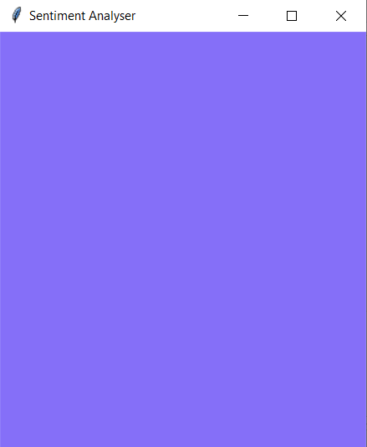
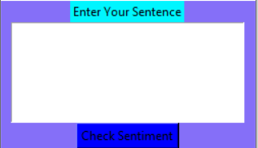
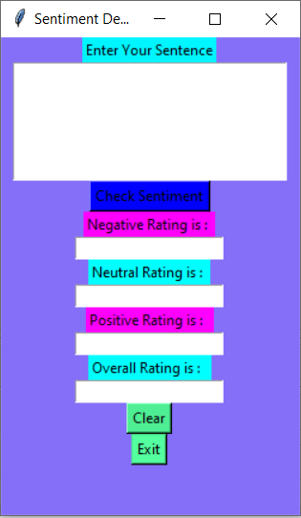

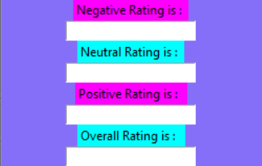
Architecture and Layout
2. A textbox for user to enter the sentence.
4. A Clear button to clear inputs and Exit button to exit
1. A view of the geometric dimension of the GUI.
3. A rating box which shows the positive, negative, neutral & overall percentage of the sentence.
5. Overall Look of GUI

Slide 5
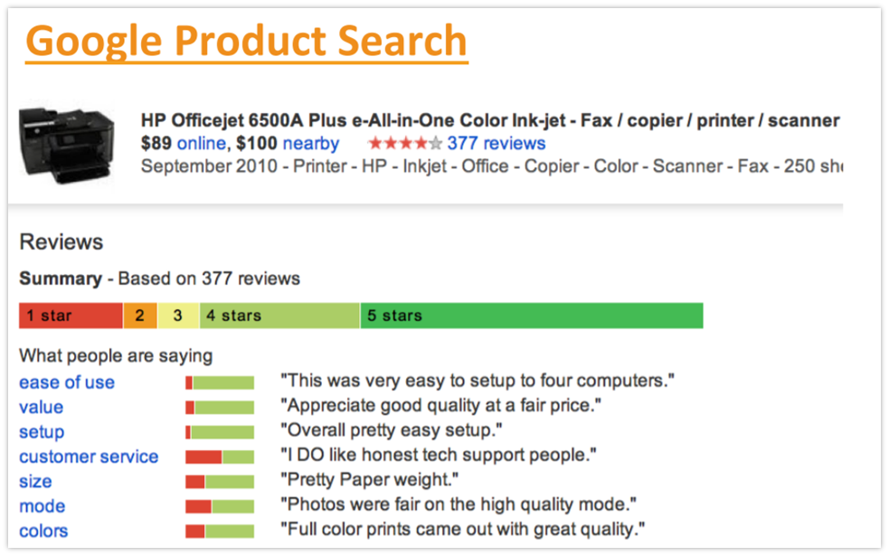
Applications of sentiment analysis
Market and competitive research.
Social media monitoring.
Customer support and feedback.
Product analysis.
An example of how the user’s experiences are recorded, analyzed and visualized in the form of rating.

Slide 6
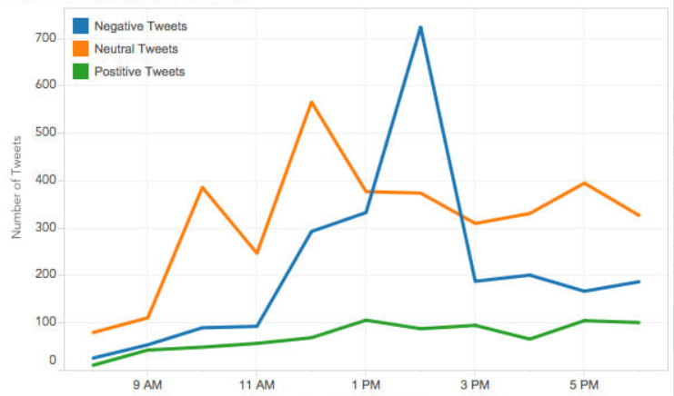
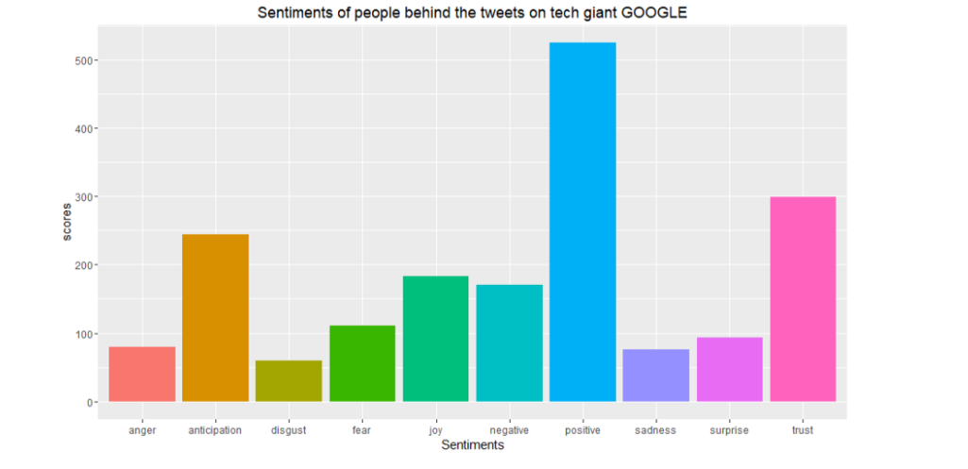
Statistical Significance
1. A study of the time-series tweets on the launch day of the iPhone X.
2. A result of sentiment analysis performed on GOOGLE .

Slide 7
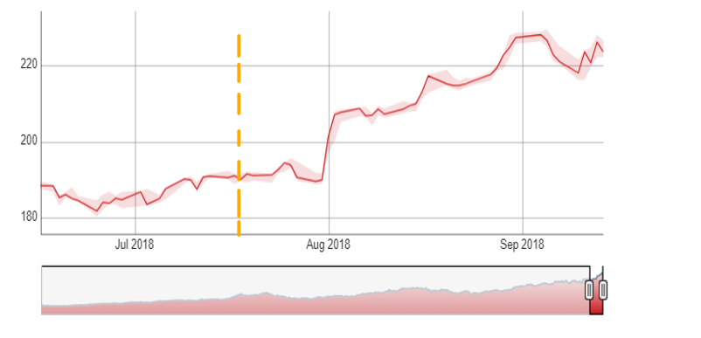
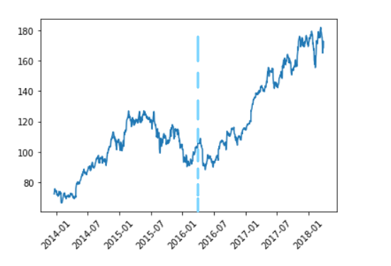
Before Vs After
Before
Before
Before
After
After
1.Sales of Swiggy before and after the use of Sentiment Analysis.
2. Revenue generated by Google half-yearly before and after use of Sentiment Analysis.

Slide 8
Flow of code
This tool comprises of 2 libraries and 3 functions.
Libraries used are :-
1] VADER
2] Tkinter
User-defined Functions :-
1] detect_sentiment()
2] clearAll()
3] quit()
All these functions are embedded within the main function in order to make the entire GUI complete along with the layout, labels, buttons and placement.

Slide 9
VADER
VADER stands for Valence Aware Dictionary for Sentiment Reasoning.
Sentiment analysis is a text analysis method that detects polarity within the text, whether a whole document, paragraph, sentence, or clause.
VADER’s SentimentIntensityAnalyzer() takes in a string and returns a dictionary of scores in each of four categories:
negative
neutral
positive
compound
The sentence is overall negative if the score is <= -0.05 and positive overall if the sentence has a score of >=0.05 and the intermediate would be neutral.

Slide 10
Tkinter
Tkinter is the standard GUI library for Python. Python when combined with Tkinter provides a fast and easy way to create GUI applications.
Tkinter was the first GUI of python since the year of 1990.
In this implementation we use the following widgets in Tkinter :
Entry( )
Text( )
Label( )
Button( )
Grid( )
Get( )
Insert( )

Slide 11
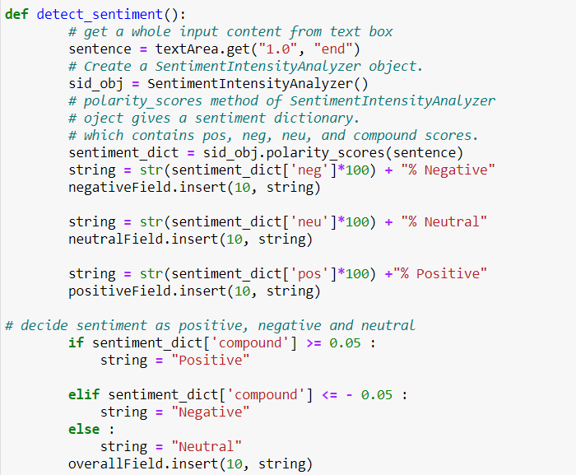
Function 1 : detect_sentiment()
The detect_sentiment( ) function is a user defined function. This function is the core part of the GUI and the classified sentence are computed based on this function.
This function takes the given sentence or a paragraph and it implicitly compares the sentence with the dictionary and generates the polarity score.
The button check sentiment’s command is assigned to the detect_sentiment( ) function in order to compute the polarity score. The result hence computed is inserted into the respective rating boxes.
Code Snippet :-

Slide 12
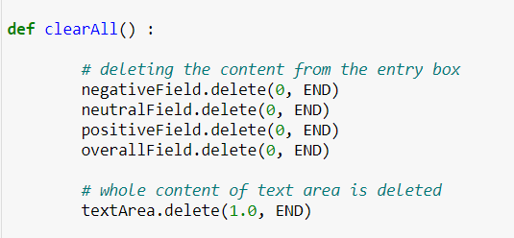
Function 2 : clearAll()
The purpose of the clearAll( ) function is to clear the text area and all the rating fields in order to prepare the GUI for the user’s next input.
The clearAll( ) function is assigned as a command to the button clear which when clicked by the user clears the GUI entirely .
Code Snippet :-

Slide 13

Function 3 : quit()
This is a user defined function that stops the execution of the GUI and exits the GUI bringing the user back to the working tab.
There are multiple ways to exit a GUI but the most simple method is to use the destroy( ) method.
The Quit button’s command is assigned to the function quit in order to perform this action.
Code Snippet :-

Slide 14

Problems that can be overcome.
In today’s modern world the use of sentiment analysis is widely increasing and many business problems are having a boost by using this technique.
Customer satisfaction analysis.
Market competition analysis.
Media monitoring.
Brand insights and buying behaviour.
Market basket analysis.

Slide 15
Future Scope
The future of sentiment analysis is going to continue to dig deeper, far past the surface of the number of likes, comments and shares, and aim to reach, and truly understand, the significance of social media interactions .
Many individuals and non profit organizations would continue to perform their analysis on their respective social media.
Brands such as Swiggy, Zomato and Domino’s are increasing their reach out to sentiment automation in order to know the buying behaviour of customers.
Companies such as Amazon and Flipkart have already employed the use of Natural Language Processing along with sentiment analysis to get a clear perspective of their sellers and customers.

Slide 16
Conclusion
The field of sentiment analysis is an exciting new research direction due to large number of real-world applications where discovering people’s opinion is important in better decision-making. The development of techniques for the document-level sentiment analysis is one of the significant components of this area. Recently, people have started expressing their opinions on the Web that increased the need of analysing the opinionated online content for various real-world applications.
Now and the upcoming years continues to drive the analytics machine forward. With more and more organizations turning to sentiment analysis to measure and predict outcomes, as well as better understand consumer behaviours , these tools are quickly building a reputation that is going to help propel it forward into the future and towards deeper and more accurate conclusions and insights.

Slide 17
We are grateful for your patient listening.
Thank You.
Project By : -
Sai Ram . K
Sai Tarun .S.S
Samhitha.V.Gowda

